Slide 2
Agenda for Webinar
Introduction
History
Overarching Challenges
Discussion of Categories
Program Initiatives
Career Development
Congressional Language
Challenges
Innovation
Convergence
Funding Opportunities
Letter of Intent
Preproposal
Full Application requirements
Dates to Remember
Tips for Success
Pitfalls

Slide 3

PRCRP Introduction
History – Began in Fiscal Year (FY) 2009 with an appropriation of $16 Million (M) and Congressional language directing the topic areas (specific cancers and other research areas) to be funded. From FY09-FY22, a total of 35 topic areas have been included under the PRCRP.
  FY09-FY21^{y}: $654.8 M, 920 awards
  FY22: $130 M, TBD*
Vision – To advance mission readiness of those U.S. military members affected by cancer and to improve quality of life by decreasing the burden of cancer on Service members, their families, Veterans, and the American public.
Mission – To successfully promote high-impact cancer research for prevention, detection, treatment, quality of life, and survivorship.
^{Ψ}FY21 Awards are under negotiation to be finalized 30 September 2022
*TBD: To Be Determined

Slide 4
FY22 PRCRP Congressional Language
FY22 Topic Areas
FY22 Details
Bladder Cancer
Blood Cancers
Brain Cancer
Colorectal Cancer
Endometrial Cancer
Esophageal Cancer
Germ Cell Cancers
Head and Neck Cancer
Liver Cancer
Lymphoma
Mesothelioma
Metastatic Cancers
Myeloma
Neuroblastoma
Pediatric brain tumors
Pediatric, Adolescent, and Young Adult Cancers
Sarcoma
Stomach Cancer
Thyroid Cancer
Von Hippel-Lindau syndrome malignancies (excluding cancers of the kidney and pancreas)
FY22 Topics areas = 20 (including new or returning)
Prohibited cancers:
  Breast Cancer
  Pancreatic Cancer
  Prostate Cancer
  Ovarian Cancer
  Kidney Cancer
  Lung Cancer
  Melanoma
  Rare Cancer
The inclusion of the individual rare cancer research program shall not prohibit the peer-reviewed cancer research program from funding the above-mentioned cancers or cancer subtypes that may be rare by definition
Relevance to Service Members and their families required

Slide 5
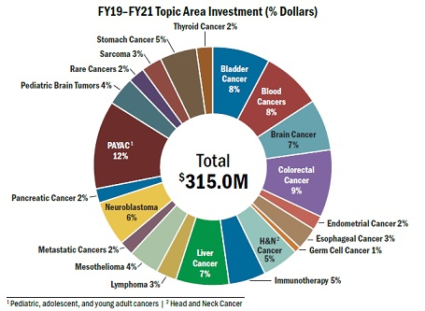
PRCRP: Brain Cancers
Brain Cancer, Pediatric Brain Tumors, Neuroblastoma
General Military Health Facts
Funding: FY09-FY21
Glioblastoma is the 3rd most common cause of cancer-related death in the US active duty population.
Veterans deployed to Iraq, Afghanistan 26% higher rate of brain cancers than the general population.
  General population 3.2 cases/100,000 people
  Active duty/Veteran population 5.2 cases/100,000
Age of onset
  General population: 64 years
  Active duty/Veteran population: 30-39 years
Topic Area | #Awards | Investment
FY09-FY21* Pediatric Brain Tumor | 52 | $29.7M
FY17-FY21 Brain Cancer | 36 | $25.3M
Total |  | $55M
*Pediatric Brain Tumors: FY09-FY10; FY12-FY14; FY16-FY21
https://www.military.com/daily-news/2022/01/11/young-and-dying-veterans-are-getting-brain-cancer-and-struggling-get-benefits.html

Slide 6
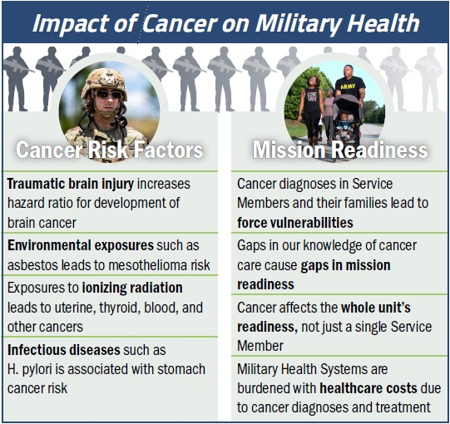
FY22 Congressional Language:
Relevance to Military Health Focus Areas
Required for All Funding Opportunities
Environmental/Exposure risk factors associated with cancer (e.g., ionizing radiation, chemicals, infectious agents, and environmental carcinogens)
Gaps in cancer research that may affect mission readiness
  Gaps in cancer prevention, early detection/diagnosis, prognosis, and/or treatment
  Gaps in quality of life and/or survivorship
https://cdmrp.army.mil/prcrp/pdf/Cancer%20Risk%20Table%202022.pdf

Slide 7
FY22 PRCRP Cancer Capability Gaps
Overarching Challenges
→Develop prevention strategies/early detention methods
→Identify/Elucidate mechanism to improve prevention
→Identify strategies to predict treatment, recurrence, resistance
→Distinguish features driving cancer occurrence across the age spectrum
→Develop minimal invasive detection
→Transform Cancer Treatment
→Advance Immunotherapy
→Multidimensional studies of biospecimens
→Elucidate mechanisms to improve treatment
→Develop open access platform(s) or methods/tools to coordinate & integrate multiple databases and biorepositories interfaces
→Develop strategies to address survivorship issues
→Develop strategies to reduce short/long term treatment effects
→Improve prevention, diagnosis, treatment, outcomes in underserved, under recognized populations
→Develop strategies to improve access to care
Prevention Diagnostics Treatment Behavioral Diversity Resources

Slide 8
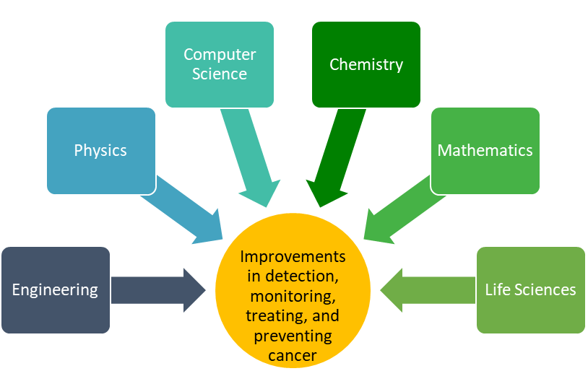
FY22 PRCRP Strategic Plan:
Convergent Science Approach
Initiative I: Convergence and Career Development
  Virtual Cancer Center
  Aims to enhance the career development stage with the inclusion of convergent science training to include military health
Initiative II: Innovation and Impact
  Opportunity to support innovative, impactful ideas
  Opportunity to enhance support of clinically relevant ideas
  Opportunity to invest in convergent science
Convergent science* “is a means of solving vexing research problems, in particular, complex problems… It entails integrating knowledge, methods, and expertise from different disciplines and forming novel frameworks to catalyze scientific discovery and innovation.”
*https://www.nsf.gov/od/oia/convergence/index.jsp

Slide 9
PRCRP Strategic Plan
Funding Opportunities
Convergence Science
FY20 Virtual Cancer Center*
Innovation and Impact
Career Development Award - Fellow Option
Career Development Award – Scholar Option
Convergent Science Cancer Consortium Development Award
Idea Award
Impact Award
Translational Team Science Award
Behavioral Health Science Award
*FY20 Virtual Cancer Center Director Award not offered in FY22

Slide 10
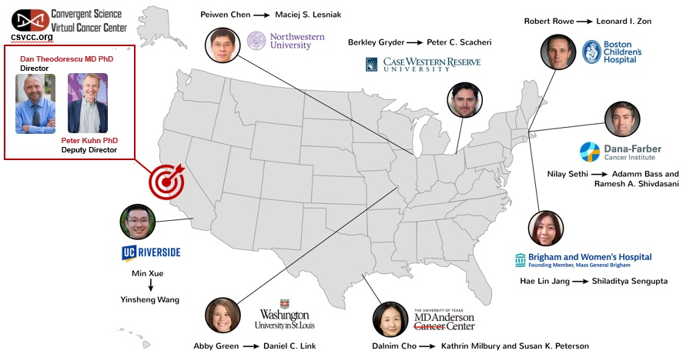
FY20- FY24 PRCRP Virtual Cancer Center
Virtual Cancer Center Director Award: $2.1M: Career Development Award – Scholar Option: $10.5M -- Total Investment: $12.6M

Slide 11
FY22 PRCRP Funding Opportunities Available
Letter of Intent – No Invitation needed
Career Development Award
Virtual Cancer Center Scholar Option
$800,000 in direct costs (4 year period of performance)
Fully independent, tenure track Assistant Professor (< 7 yrs terminal degree)
Fellow Option
$400,000 in direct costs (3 year period of performance)
Independent investigators at level of Research Assistant Professor, Instructor (<7 yrs terminal degree)
Supports the addition Scholars to the unique, interactive Virtual Cancer Center
Must address FY22 Topic Areas, Military Health Focus Areas, and Overarching Challenges
Provides intensive mentoring, national networking, and a peer group for junior faculty
Supports early-career investigators toward further independence to conduct impactful research with the mentorship of an experienced cancer researcher
Must address FY22 Topic Areas, Military Health Focus Areas, and Overarching Challenges

Slide 12
FY22 PRCRP Funding Opportunities Available
Letter of Intent – No Invitation needed
Convergent Science Cancer Consortium Development Award
Coordinating Center
Research Site 1
Research Site 2
Research Site 3
Steering Committee
$2.5M direct costs 2 year period of performance
PI for Coordinating Center (Consortium Director): Investigators at or above the level of Associate Professor; Co-PI for the Research Site: Investigators at or above the level of Assistant Professor
Supports novel approaches to ending cancer
Proof of principle (convergent science) research projects support
Emphasis is on the development of a convergent science infrastructure
Address 3 FY22 PRCRP Topic Areas
Address FY22 PRCRP Military Health Focus Area
Address 1 FY22 PRCRP Overarching Challenge
External Advisory Board
Topic Area 1
Topic Area 2
Topic Area 3
One Overarching Challenge

Slide 13
FY22 PRCRP Funding Opportunities Available
Letter of Intent – No Invitation needed
Behavioral Health Science Award
$1M in direct costs (4 year period of performance)
Supports research that spans the spectrum of behavioral health science including prevention, survivorship, quality of life, and psychosocial research related to cancer – Pilot Clinical Trials allowed
Translational Team Science Award
$2.5M in direct costs (4 year period of performance)
Independent investigator with a faculty-level appointment (or equivalent)
Must address FY22 Topic Areas, Military Health Focus Areas, and Overarching Challenges
At least 2-3 PIs (at the level of Assistant Professor or equivalent)
Must address FY22 Topic Areas, Military Health Focus Areas, and Overarching Challenges
Supports translational studies associated with an ongoing or completed clinical trial that can lead to a future clinical trial or clinical application in cancer research – Clinical Trials allowed

Slide 14
FY22 PRCRP Funding Opportunities Available
Preproposal – Invitation Required
Idea Award
Impact Award
$400,000 direct costs (2 year period of performance)
Independent investigator/ faculty-level appointment
Supports innovative, untested, high-risk/ potentially high-reward concepts, theories, paradigms, and/or methods in cancer
$1M direct costs 3 year period of performance
Independent investigators at or above the level of Assistant Professor
Supports research projects that, if successfully addressed, have the potential to make a near-term, major impact
Must address FY22 Topic Areas, Military Health Focus Areas, and Overarching Challenges
Must address FY22 Topic Areas, Military Health Focus Areas, and Overarching Challenges
Clinical Trials allowed

Slide 15
Dates to Remember
Submission Deadlines
Funding Opportunity | LOI or Preproposal/ Date |  | Invitation to Submit | Full Application Deadline | Verification Deadline
Behavioral Health Science | LOI | 12 July 2022 | Not needed | 2 August 2022 | 9 August 2022
Career Development Award – Scholar Option | LOI | 12 July 2022 | Not needed | 2 August 2022 | 9 August 2022
Career Development Award – Fellow Option | LOI | 12 July 2022 | Not needed | 2 August 2022 | 9 August 2022
Translational Team Science | LOI | 12 July 2022 | Not needed | 2 August 2022 | 9 August 2022
Convergent Science Cancer Consortium Development | LOI | 17 August 2022 | Not needed | 7 September 2022 | 14 September 2022
Idea | Pre-proposal | 25 May 2022 | 11 July 2022 | 7 September 2022 | 14 September 2022
Impact | Pre-proposal | 25 May 2022 | 11 July 2022 | 7 September 2022 | 14 September 2022

Slide 16
Strategies for Success
Plan Ahead
Impact
Deadlines are important!
Coordinate your efforts → bring the team together early
Cool science is good → Impactful science is great!
Show how it is impactful, important to patients
Use plain language! You will be evaluated on this!
Grantsmanship
Feasibility
Clear voice, forget the jargon → don’t tire the reviewers
Review your documents prior to submission → use the verification period!
Use the Peer Review Criteria as your check list!
Clearly define your team’s skills
Outline your justification on how and why you can achieve the anticipated outcomes
Intent
Impact
Plan
What’s the Intent
The Ted Talk → state your idea upfront, then back it up!
Make your case to how your research aligns with the intent

Slide 17
Pitfalls to Avoid in
Application Submission
FY22 Panel Member Organization
Lt Col Della Howell, M.D. (Chair), Brooke Army Medical Center
Clark Chen, M.D., Ph.D., University of Minnesota
Dan Dixon, Ph.D. , University of Kansas Medical Center
Paul Doetsch, Ph.D., National Institute of Environmental Health Sciences
LCDR Michelle Gage, M.D., Walter Reed National Military Medical Center
Adam Hayden, National Brain Tumor Society
Douglas Hawkins, M.D., Seattle Children’s Hospital
Yi-Fen Lee, Ph.D., University of Rochester
Barbara Lind, Society of Gynecological Oncology
Aaron Mansfield, M.D., The Mayo Clinic
Robert Mesloh, M.P.M., Lymphoma Research Foundation
COL (Ret) Thomas Newton, M.D., Inova Schar Cancer Institute
Kenneth Tanabe, M.D., Massachusetts General Hospital
Chiaojung Jillian Tsai, M.D., Ph.D., Memorial Sloan Kettering Cancer Center
Do not include Programmatic Panel members for the program and fiscal year to which you are applying
Do not exceed the page limits; check files after creating PDF version
Do not miss the submission deadline
  Grants.gov validation may take up to 72 hours
  System-to-system submissions are sometimes problematic
  Application verification in eBRAP is possible before the deadline
Do NOT ignore the Verification Period!
Submit the correct Project Narrative and Budget
  These components cannot be modified during the verification period in eBRAP
17

Slide 18
Let’s Talk Common Questions
I’m not from the US, can I still apply?
Do I have to use a military population in studies
Yes, you will need to register with SAM; see the General Application Instructions for more information.
No. That’s not necessary. You use a population that is representative. I cannot help you collaborate with a military research center.
When are the due dates?
Where do I apply?
You can find the due dates on the front page of every program announcement.
Start your application on ebrap.org
Find the funding opportunities on cdmrp.army.mil or grants.gov – listing number 12.420
Can a post-doc apply to the Career Development Award?
Can we get a copy of this briefing
No, the Career Development Award, both Scholar and Fellow options. require a degree of independence. You can be a Research Assistant Professor or Instructor for the Fellow Option.
Yes. I am sure that NBTS will be able to provide it to you.

Slide 19
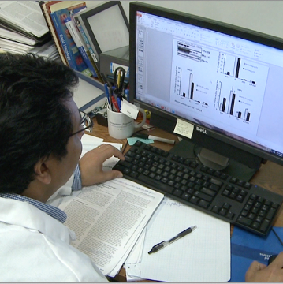

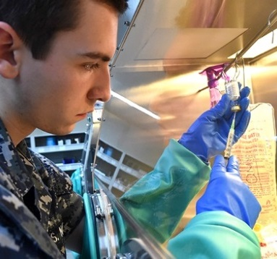
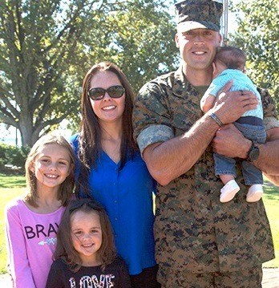

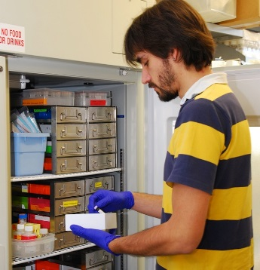
For more information, please visit: https://cdmrp.army.mil/prcrp
More information on CDMRP, the review system, how to apply: https://cdmrp.army.mil/pubs/Webinars/webinar_series

